Slide 1
Smart Disaster Management: The Role of AI in Predictive Analytics and Emergency
Submitted in the partial fulfillment for the award of the degree of
BACHELOR OF ENGINEERING
IN
COMPUTER SCIENCE & ENGINEERING
Submitted by:
Sidharth Parmar (22BAI71078)
Kamakshi Sharma (22BAI71125)
Harish (22BAI71048)
Amit (22BAI70169)
Under the Supervision of:
Dr. Mahadev
Department of AIT-CSE
DISCOVER . LEARN . EMPOWER

Slide 2
Outline
Introduction to Project
Problem Formulation
Objectives of the work
Methodology used
Results and Outputs
Conclusion
Future Scope
References

Slide 3
Introduction to Project
The number and intensity of both natural and man-made calamities are rising globally.
Traditional ways of managing disasters are mostly "reactive," meaning they respond after an incident occurs.
This reactive approach causes delayed emergency response, leading to significant harm to human lives and destruction of infrastructure.
Artificial Intelligence (AI) can transform this field, shifting it towards "proactive" management by anticipating events.
AI can use machine learning, remote sensing, and IoT data to provide rapid situational awareness and a more accurate estimation of the disaster's impact.

Slide 4
Problem Formulation
Disasters (floods, wildfires, etc.) are increasing in frequency and scale due to climate change and urbanization.
Typical disaster management is reactive, causing slow responses and wasted resources.
Despite new sensor tech, data is fragmented and underutilized, failing to generate intelligence.
Existing predictive models lack scalability, interpretability, and sufficient data in developing nations.
In India, multilingual processing and infrastructure gaps further compromise AI-based responses.

Slide 5
Objectives of the Work
Broad Objective: To examine and highlight the role of Artificial Intelligence in predictive analytics for disaster management, including international and Indian cases.
Specific Aims:
To overview existing AI-oriented models for different hazards (floods, earthquakes, wildfires) and outline their strengths and difficulties.
To evaluate the performance of AI-based early warning systems in reducing response time and improving decision support.
To assess the use of AI to integrate IoT, remote sensing, and social media for real-time situational awareness and hazard estimation.
To discuss Indian case studies and their specific challenges (linguistic diversity, infrastructural shortages).

Slide 6
Methodology used
Input Data:
Satellite Imagery: Sentinel-1 (floods), MODIS/VIIRS (wildfires).
Meteorological Data: Rain, temperature, wind, humidity.
Seismic Data: P-wave & S-wave amplitudes.
IoT Sensors: River levels, fire sensors.
Social Media: Citizen reports & images.
Data Preprocessing:
Noise Filtering: Lee filter for SAR data.
Normalization: Scaling features to [0, 1].
Feature Extraction: e.g., FFT of seismic data

Slide 7
Methodology used
Predictive Modeling (AI Models):
Flood Prediction: CNN + LSTM Hybrid.
Earthquake (EEW): 1D-CNN + GRU (on P-waves).
Wildfire Detection: Transformer-based Attention Network.
Risk Assessment & Output:
Risk Assessment: A "Combined Hazard Index ($HI_{combined}$)" is computed.
Alerts: Threshold-based (Red, Yellow, Green) alerts are issued.
Output: Optimizes Resource Allocation for emergency teams.

Slide 8
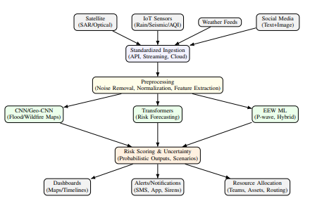
Methodology
Fig:Proposed AI-driven disaster management pipeline: from multimodal data ingestion to probabilistic decisionmaking and operational outputs.

Slide 9
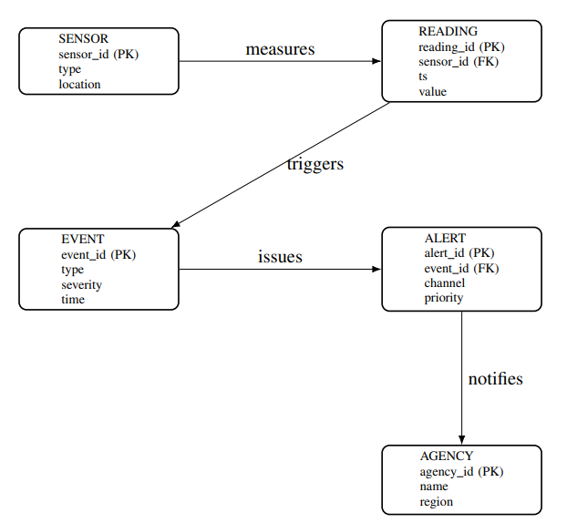
FIG: ER model for disaster management data platform.

Slide 10
Results and Outputs
Flood Case Study: The proposed AI-based ensemble models performed better in detection than baseline thresholding methods. It successfully reduced "speckle noise" in SAR data, leading to improved flood delineation and a lower probability of false alarms.
Earthquake (EEW) Case Study: The system, using short segments of P-waves, had shorter prediction latency than traditional seismic models.
Wildfire Case Study: Transformer-based models were found to be more accurate in risk assessment. Using multimodal inputs (satellite + ground sensors) reduced false positives and maximized recall.
Comparison:
In EEW, a 3-5 second reduction in latency was found compared to conventional models.
In wildfire detection, recall was improved by nearly 10%.

Slide 11
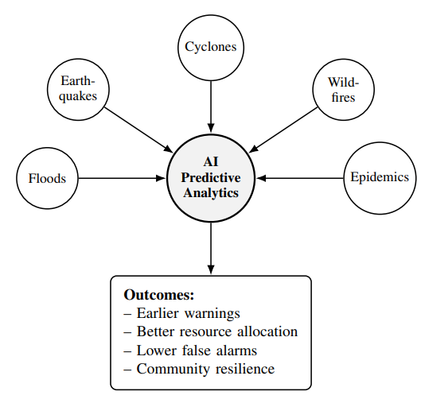
Output
Fig. : How AI connects diverse hazards to actionable outcomes in disaster management.

Slide 12
Conclusion
This research highlights that AI models (like CNN, RNN, Transformers, and ensembles) significantly increase the accuracy of disaster forecasting.
The proposed framework outperforms existing methods by integrating heterogeneous data sources and using probabilistic decision-making.
Key Limitations (Challenges):
  Data Paucity: Quality and coverage of data remain a major problem, especially in developing countries.
  Model Generalization: Models still struggle to generalize across different geographical or climatic regions.
  Infrastructure: Real-time implementation requires huge computation capacity and close integration with national disaster agencies (like NDMA).

Slide 13
Future Scope
To develop "adaptive models" that can work with different regions without needing extensive retraining.
To incorporate "Federated Learning" and privacy-preserving procedures to share datasets across agencies without infringing on privacy.
To further develop multilingual social media analysis for true situational awareness, particularly in environments like India.
To conduct wide-area "field testing" and collaborate with disaster management agencies (e.g., NDMA, IMD) to verify performance and improve deployment strategies.

Slide 14
References
[1] S. Nevo, M. Cohen, and Y. Kogan, ”Flood forecasting with machine learning models in an operational system,” Hydrol. Earth Syst. Sci., 2022. Outcome: operational ML + inundation mapping; Limitation: ungauged/low-data transfer.
[2] K. Halder, S. Roy, and P. Das, ”SAR-driven flood inventory and multifactor ensemble: Malda district, India,” Geocarto Int., 2024. Outcome: improved flood-patch detection; Limitation: speckle/threshold sensitivity.
[3] R. Soudagar, A. Chowdhury, and A. Bhardwaj, ”Morphological active contour model for flood extent mapping: 2023 North Indian floods,” IEEE IGARSS, Athens, 2024. Outcome: single-scene delineation; Limitation: cross-basin generalization.
[4] R. Soudagar, A. Chowdhury, and A. Bhardwaj, ”Enhanced large-scale flood mapping using data-efficient unsupervised MAC,” J. Environ. Manage., 2025. Outcome: scalable mapping; Limitation: dependence on DEM/initialization.
[5] A. Singh, R. Das, and S. Kumar, ”Random-Forest-based flood monitoring using Sentinel-1: Northeast India,” 2022. Outcome: exposure mapping; Limitation: class imbalance, limited ground truth.
[6] O. Andrew, P. Lee, and S. Kim, ”CNN-based deep learning for flood susceptibility mapping,” ISPRS Int. J. Geo-Inf., 2023. Outcome: higher accuracy than RF/SVM; Limitation: overfitting small regions.
[7] C. Ding, L. Zhao, and H. Wang, ”Wildfire detection through deep learning and geostationary imagery,” Int. J. Remote Sens., 2022. Outcome: improved monitoring latency; Limitation: cloud/illumination artifacts.
[8] A. Saleh, B. Li, and K. Chen, ”Forest fire surveillance systems: a review of deep learning methods,” Heliyon, 2024. Outcome: SOTA survey; Limitation: benchmark fragmentation.

Slide 15
References
[9] Z. Xu, Y. Liu, and P. Zhang, ”Deep learning for wildfire risk prediction: integrating remote sensing climate,” ISPRS J. Photogramm. Remote Sens., 2025. Outcome: risk mapping gains; Limitation: domain shift.
[10] L. He, M. Sun, and X. Wang, ”Deep learning object detection for forest fire smoke (YOLOv11x),” Sci. Rep., 2025. Outcome: faster smoke alerts; Limitation: false positives/night detection.
[11] J. X. Lian, H. Tanaka, and S. Ito, ”Integrating ML with equal differential time for EEW,” Earth, Planets and Space, 2024. Outcome: better hypocenter estimates; Limitation: network-specific tuning.
[12] Y. Nakamura, T. Suzuki, and K. Saito, ”EEW starting from 3 s of P-waves via ML,” J. Geophys. Res., 2023. Outcome: earlier magnitude/location; Limitation: small-event performance.
[13] F. Rossi, G. Bianchi, and L. Verdi, ”AI-based EEW systems: a systematic review,” 2023. Outcome: NN dominance; Limitation: inconsistent metrics/latency reporting.
[14] X. Pan, Q. Li, and Y. Chen, ”Synthetic + real waveform ensemble for earthquake magnitude prediction,” Seismol. Res. Lett., 2024. Outcome: stabilized magnitude; Limitation: synthetic data bias.
[15] R. Bhatia and A. Singh, ”Multilingual GRU-based disaster tweet classification in India,” 2023. Outcome: improved urgent/non-urgent tagging; Limitation: handling code-mixed content.
[16] P. Sharma, M. Verma, and S. Gupta, ”CNN-attention multimodal disaster tweet analysis,” 2024. Outcome: better damage severity classification; Limitation: large annotated datasets required.

Slide 16
References
[17] S. Alam, H. Rahman, and T. Chen, ”Multimodal social media analytics for disaster situational awareness,” Int. J. Inf. Manage., 2023. Outcome: improved recall/precision; Limitation: high annotation cost.
[18] A. Srivastava and R. Mehta, ”AI applications in Indian urban disaster management,” 2024. Outcome: improved cyclone/flood predictions; Limitation: integration with NDMA/IMD required.
[19] K. Halder, S. Roy, and P. Das, ”Sentinel-1 ensemble flood prediction in India,” 2024. Outcome: higher accuracy; Limitation: sensitivity to speckle/thresholds.
[20] P. Sharma, M. Verma, and S. Gupta, ”Multimodal Indian disaster tweet processing,” 2024. Outcome: improved situational awareness; Limitation: multilingual code-mixing.
[21] O. Andrew, P. Lee, and S. Kim, ”CNN-based flood susceptibility mapping,” 2023. Outcome: higher accuracy; Limitation: overfitting risk.
[22] Z. Xu, Y. Liu, and P. Zhang, ”Transformer-based wildfire prediction,” 2025. Outcome: improved precision/recall; Limitation: domain shift.
[23] J. X. Lian, H. Tanaka, and S. Ito, ”Equal differential time ML for earthquake EEW,” 2024. Outcome: reduced latency; Limitation: networkspecific tuning.

